Slide 1


Consistency models
SE3331-1 (2023 Fall)
IPADS, Shanghai Jiao Tong University
https://www.sjtu.edu.cn
Credits: Rong Chen@IPADS, jinyang Li@NYU

Slide 2



Review: key-value storage (KVS)
Storage abstraction:
Each data (Value) is opaque to the underlying storage/database
The K and V can be arbitrary byte-sequence (e.g., JSON, int, string)
Indexed by a key (K), which itself is also a data
Stored on disk (tolerate failure & support a large capacity)
Application-level Interface (API)
Get(K) -> V, Scan(K,N)
Update(K,V), Insert(K,V), Delete(K,V)
Notes:
实现这个 + 子集

Slide 3
Review: naïve KVS
Storage abstraction remapping:
Key → The file name
Assume the key is not so long
Value → The file content
So we can store each K,V as a file ☺
Application-level Interface (API)
Get(K) -> V is similar to OPEN(…) + READ(…)
Update(K,V) -> is similar to OPEN(…) + WRITE()
Insert(K,V) -> is similar to CREATE(…) + WRITE(…)
Etc.

Slide 4
LSM Tree organizes SSTables in a hierarchy
The famous Log-structured merge tree
Each layer has the entire KVS data of some time
Each layer has maximum size
Except L0, all files in layers are sorted, and does not have duplicated keys
New
MemTable
L0
L1
L2
LSM Tree
Old

Slide 5
Hierarchy can speed up old value lookup
Each layer has only one file that store the key (except L0)
So we can search only one file per-layer (not per-file search)
Question: how to find the key file?
Many methods exist
E.g., store a [min, max] per file in memory
Read upon lower layers
First identify the file, then look it!
O(1) access per layer
MemTable
New
L0
L1
L2
LSM Tree
Old
Notes:
Each layer has only one

Slide 6
Hierarchy can speed up range query
Store a [min, max] per file
Range query
Query layer-by-layer
Then merge the results
New
MemTable
L0
L1
L2
LSM Tree
Old
Notes:
Each layer has only one

Slide 7
Range Query in LSM Tree
Search each layer using binary search
Merge the results of each layer
Not as good as B+Tree,
but is much better than hash & logs without hierarchy! !
New
MemTable
L0
L1
L2
LSM Tree
Old

Slide 8
Example: Read in LSM-Tree (Similar to SSTables)
MemTable
Key
Memory
Disk
Level₀
…
…
SSTable
Level₁
KV pairs
(sorted)
…
Level_{k}
…
Metadata

Slide 9
Example: Read in LSM-Tree
MemTable
KV pairs
Memory
Disk
…
Search L0 sequentially
Level₀
…
SSTable
Level₁
KV pairs
(sorted)
…
Level_{k}
…
Metadata

Slide 10
Example: Read in LSM-Tree
MemTable
KV pairs
Memory
Disk
…
Search L0 sequentially
Level₀
…
SSTable
Level₁
KV pairs
(sorted)
…
Level_{k}
…
Metadata
Notes:
为啥L0没有sorted？主要是为了快速将 memtable 刷到 l0里去，不能成为性能瓶颈

Slide 11
Example: Read in LSM-Tree
MemTable
KV pairs
Memory
Disk
Search lower layer using binary search
Level₀
…
…
SSTable
Level₁
KV pairs
(sorted)
…
Level_{k}
…
Metadata

Slide 12
Example: insert/update in LSM-Tree
MemTable
KV pairs
Full
Memory
Disk
Level₀
…
…
SSTable
Level₁
KV pairs
(sorted)
…
Level_{k}
…
Metadata

Slide 13
Example: insert/update in LSM-Tree
MemTable
KV pairs
Memory
Disk
Level₀
…
Compaction
…
SSTable
Level₁
KV pairs
(sorted)
…
Level_{k}
…
Metadata

Slide 14
What about crash?
MemTable is an in-memory data structure
So it is vulnerable to machine failure
Goal: a successful insertion will store the data durably
Solution:
Keep a separate log file the MemTable (may not be sorted)
Before inserting to the MemTable, adding the KV to the log first (also a sequential write); reply if the log is successful
If the machine crashed, reboot it, and reconstruct the MemTable from the log

Slide 15




LSM Tree Summary
Good when
Massive dataset
Rapid updates/insertions
Fast single-point lookup for recently updated data
Widely adopted in modern single-node key-value stores

Slide 16
LSM Tree Summary
Good when
Massive dataset
Rapid updates/insertions
Fast single-point lookup for recently updated data
Compared with B-Tree
Pros: good write performance due to sequential writes
Cons: additional compaction process, possible slow range queries,
write stall caused by the compaction, slow lookup for non-existent key

Slide 17
LSM Tree Summary
Good when
Massive dataset
Rapid updates/insertions
Fast single-point lookup for recently updated data
Compared with B-Tree
Pros: good write performance due to sequential writes
Cons: additional compaction process, possible slow range queries,
write stall caused by the compaction, slow lookup for non-existent key

Slide 18
Write stall caused by compaction in LSM Tree
MemTable
KV pairs
Memory
Disk
Level₀
…
…
SSTable
Level₁
KV pairs
(sorted)
…
Level_{k}
…
Metadata

Slide 19
Write stall caused by compaction in LSM Tree
MemTable
KV pairs
Memory
Disk
Level₀
…
…
SSTable
Level₁
KV pairs
(sorted)
…
Level_{k}
…
Metadata

Slide 20
Write stall caused by compaction in LSM Tree
MemTable
KV pairs
Full
Memory
Disk
Level₀
…
…
SSTable
Level₁
KV pairs
(sorted)
…
Level_{k}
…
Metadata

Slide 21
Write stall caused by compaction in LSM Tree
MemTable
KV pairs
Memory
Disk
Level₀
…
Compaction
…
SSTable
Level₁
KV pairs
(sorted)
…
Level_{k}
…
Metadata

Slide 22
Write stall caused by compaction in LSM Tree
MemTable
KV pairs
Memory
Disk
Level₀
…
Compaction
…
SSTable
Level₁
KV pairs
(sorted)
…
Level_{k}
…
Metadata

Slide 23
Write stall caused by compaction in LSM Tree
MemTable
KV pairs
Full
Memory
Disk
Level₀
…
Compaction
…
SSTable
Level₁
KV pairs
(sorted)
…
Level_{k}
…
Metadata

Slide 24
Write stall caused by compaction in LSM Tree
MemTable
KV pairs
Memory
Disk
Level₀
…
Compaction
…
SSTable
Level₁
KV pairs
(sorted)
…
Level_{k}
…
Metadata

Slide 25

Write stall caused by compaction in LSM Tree
Stalled due to
slow compaction
MemTable
KV pairs
Full
Memory
Disk
Level₀
…
Compaction
…
SSTable
Level₁
KV pairs
(sorted)
…
Level_{k}
…
Metadata

Slide 26
How to avoid write stall?

Slide 27
In principle, hard to prevent
Can only alleviate
E.g., speed up compaction & merge process with advanced hardware
Disk
Level₀
…
Compaction
…
SSTable
Level₁
KV pairs
(sorted)
…
Level_{k}
…
Metadata

Slide 28
In principle, hard to prevent
Can only alleviate
E.g., speed up compaction & merge process with advanced hardware
Observation: SSD is much faster than disk on storage
Using it to store up-layer SSTables
SSD
…
Compaction
Level₀
Disk
…
SSTable
Level₁
KV pairs
(sorted)
…
Level_{k}
…
Metadata

Slide 29
LSM Tree Summary
Good when
Massive dataset
Rapid updates/insertions
Fast lookups
Compared with B-Tree
Pros: good write performance due to sequential writes
Cons: additional compaction process, possible slow range queries,
write stall caused by the compaction, slow lookup for non-existent key

Slide 30
Slow lookup for non-existent key
Question: what if the key non-exist?
Recall: how LSM Tree lookup keys
Checks the MemTable
If misses, checks the latest SSTable
If still misses, checks the next older SSTable
…
Will lookup all the files!
1
2
3
4
…
MemTable
SSTables
Notes:
Solution: bloom filter

Slide 31
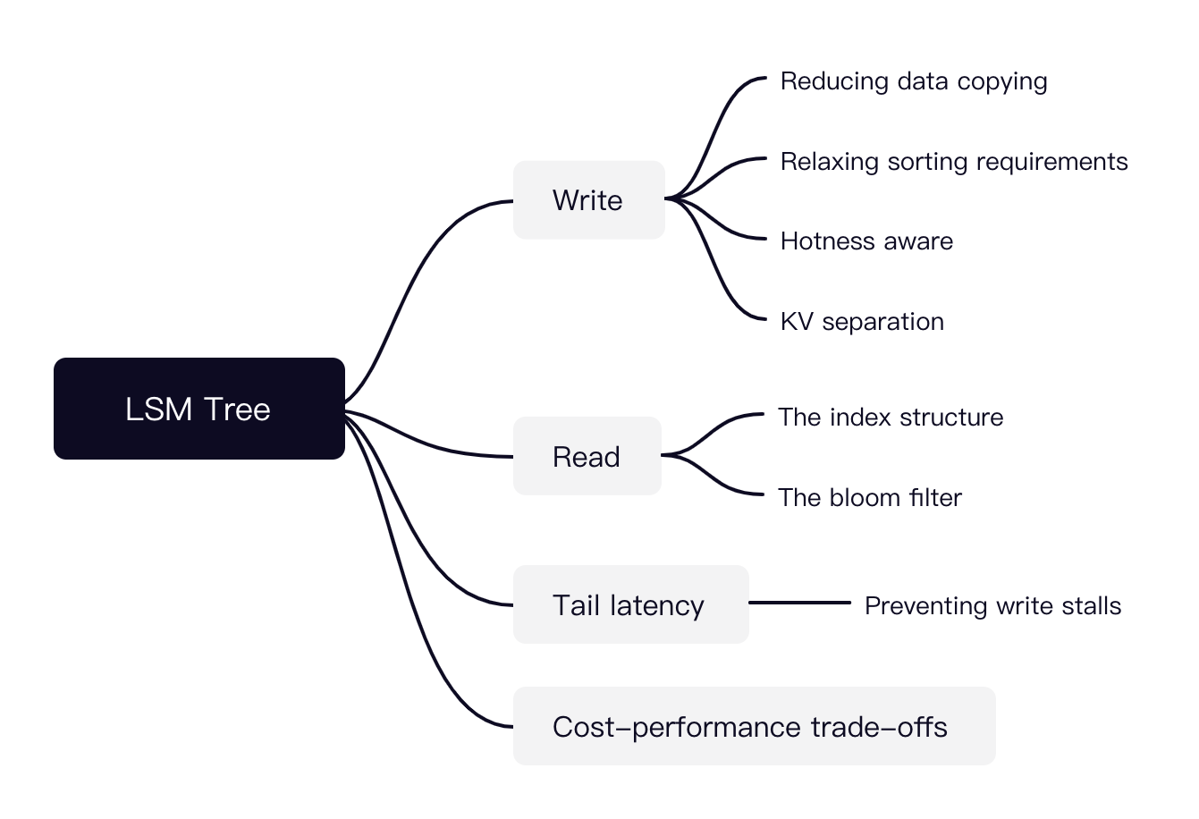
LSM Tree is a hot research topic today
Many possible directions

Slide 32
Key-value storage is a key component in large-scale website

Slide 33



Review: large-scale websites
Key-value storage is the key pillar
Caching server
Caching server
Caching server
…
Caching
Caching
Caching
Distributed caching
w/ MyRocks
Storage
- LSM Tree
Database server
Database server
CDN
Users
Application #1
generate the page
Database
user, price
…
Database
user, price
Filesystem
Application server
Distributed database
Internet
Load
Balance
Application #2
add the order
File server
File server
File server
File:
image
File:
image
…
File:
image
Application server
…
…
Message queue
Distributed file system

Slide 34
Distributed key-value storage

Slide 35
Distributed key-value storage
Make KV store distributed (see later lectures)
RPC + key-value storage = distributed key-value storage!
See the next lecture
We can also shard the data across multiple nodes
i.e., high scalability
Key challenge:
How to find the data?
E.g., consistent hashing
Other problems:
Fault tolerance (see later lectures)
Availability, replication & consistency (see later lectures)

Slide 36
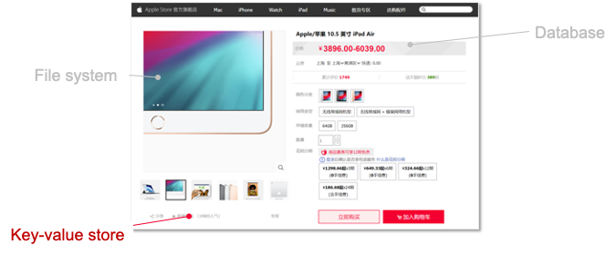
Summary of this lecture
Key-value store is an important component in computer systems
Typically built upon a filesystem to simplify disk hardware management
We show how KVS is evolved from log-structured file to the LSM tree
Log-structured file
Indexing
LSM Tree
Key-value Store
Key-value files
File system

Slide 37
Comparison
Disk | Memory | Sorted | Range Q | Get | Put
Log for key+value | No | No | No | Extremely Slow | Fast
Log for key+value | Hash table (key-index) | No | No | Medium | Fast
Hash table key+value | Cache for Hash table | No | No | Medium | Medium
B-Tree key+value | Cache for B-Tree | Yes | Yes | Slow | Slow
SSTables key+value | MemTable key+value | Partial | Yes | Slow-Medium | Fast+

Slide 38
How many disk operations for each operations?
Assumption (throughout this lecture):
The request key is selected randomly
There is no page cache, i.e., all the requests are served from the disk
For simplification, we directly use the key as the inode id
Get(K)→ V
OPEN(…) + READ(…)
1 random Disk read + 1 random Disk read + 1 random Disk read
Update(K,V)
OPEN(…) + WRITE(…)
1 random Disk read + 1 random Disk read + 1 random Disk write

Slide 39
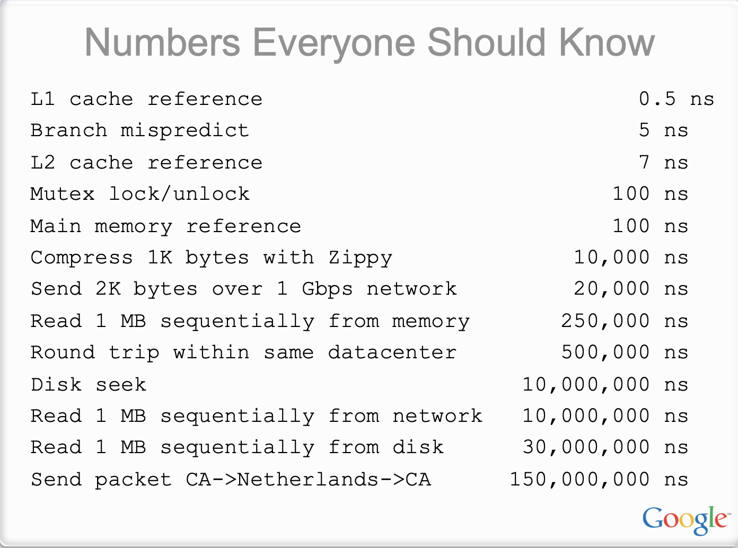
Source: Jeaf dean
Notes:
http://static.googleusercontent.com/media/research.google.com/en/us/people/jeff/stanford-295-talk.pdf

Slide 40
Numbers everyone should know (depends on the hardware)
Random read/write ~= seek + read/write
Sequential read/write = read/write
Typically, random read/write is orders of magnitude slower than sequential
Especially for small-sized values, e.g., 4KB
How to get the real estimation? Can do a simple profile (e.g., FIO)
Our testbed
4KB sequential read: READ: aggrb=208,636KB/s
4KB random read: READ: aggrb=4,409KB/s
Note that for disk, the minimal read/write unit is the block size
Notes:
Test command: sudo fio --name=fiotest --filename=/dev/sda1 --size=1G --rw=read --bs=4K --direct=1 --numjobs=8 --ioengine=libaio --iodepth=32 --group_reporting --runtime=60 --startdelay=60

Slide 41
Performance estimation of the naïve KVS
Get(K)→ V
1 random Disk read + 1 random Disk read + 1 random Disk read
Update(K,V)
1 random Disk read + 1 random Disk read + 1 random Disk write
Assumption
Each key and value are both 16B
Suppose random read perf ~= random write perf, block sz = 512B
Get = Update ~= 2.9K reqs/s
4,409KB / (512B * 3)

Slide 42
Review: A naïve Key-Value Storage (KVS) w/ log file
Suppose we store all the KV in a single file in the following format:
Key
Value
123456，'{"name":"London","attractions":["Big Ben","London Eye"]}’
42，'{"name":"San Francisco","attractions":["Golden Gate Bridge"]}’
...
Update:
One sequential WRITE
Get
One random READ (with in-memory index)

Slide 43
Performance estimation of the naïve KVS + Log file
Assumption (can be adjusted given different workload patterns)
(K,V)s are padded to 512B (smaller size makes it slower)
Update
407 K reqs/s // disk sequential write bandwidth
208,636KB / 512B
Get
8.8 K reqs/s (in the optimal case, i.e., all index are stored in the memory)
4,409KB / 512B
What if no in-memory index is given?
Too slow to be estimated …

Slide 44
Review: B+Tree to store the (K,V)s
A B-tree is a tree-like data structure
Each node is fixed-sized, can store multiple keys, and keys are sorted
Support efficient range operations (e.g., Scan)
Optimized for large read/write blocks of data
Many variants exist, a standard choice is B+Tree
All the leaf nodes of the B-tree must be at the same level
Simper to link leave nodes to support range queries

Slide 45
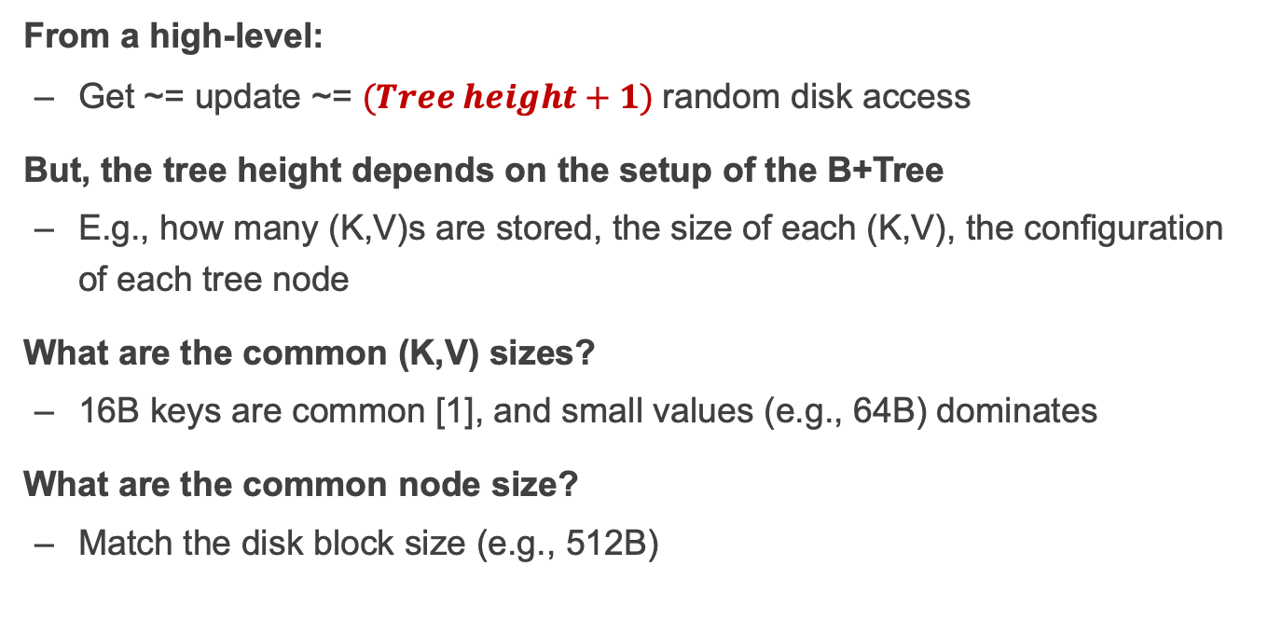
Performance estimation of B+Tree-based KVS
From a high-level:
Get ~= update ~= $(Tree height+1)$random disk access
But, the tree height depends on the setup of the B+Tree
E.g., how many (K,V)s are stored, the size of each (K,V), the configuration of each tree node
What are the common (K,V) sizes?
16B keys are common [1], and small values (e.g., 64B) dominates
What are the common node size?
Match the disk block size (e.g., 512B)
[1] Workload Analysis of a Large-Scale Key-Value Store, from Facebook

Slide 46
Performance estimation of B+Tree-based KVS
Setup
Keys are 16B, node size 512B, 1 million key-value pairs
This means up to 32 keys per node
Tree height ~= 7 (6.8) in the worst case [1]
1+ log₃₂((n+1)/2)
So Get = Update = 1.1K reqs/s
Even slower than our naïve KVS
Though it supports ordered accesses and range queries
[1] Workload Analysis of a Large-Scale Key-Value Store

Slide 47
Review: LSM Trees
Store (K,V)s in SSTables
Segmented log file + sorted (K,V)s
MemTable to simplify building SSTable
Also as a cache to absorb recent updates for sequential disk writes
SSTable’s are organized as layers
To accelerate old key lookups & range queries
Each layer has an (in-memory) sparse index to accelerate the lookup (O(1) lookup per layer)
MemTable
New
L0
SSTable
L1
LSM Tree
Old

Slide 48
Performance estimation of the LSM (Much harder)
Update (not considering compaction & merge)
MemTable not full: DRAM write bandwidth (>> disk sequential write)
MemTable full: disk sequential write
Get is even harder. We can only measure #disk accesses for different Get scenarios (Trade READ for WRITE)
Optimal case: 0 (in the MemTable)
Worst case: number of layers random disk accesses
The number of levels can vary but is often between 4 and 7 in practice.
Typically the number is small, because each SSTable is large (>> than block size)
Not slower than the naïve log file

Slide 49
Building applications on KVS

Slide 50


Motivating application: Chat APP
Abstracted data type
Chat: a chat to someone (or a group)
Sentence: the detailed sentence from a conversion
Operation: add a sentence to a chat
Typical system to support the APP: key-value storage
E.g., each sentence can be uniquely identified by <sid, "some sentence”>
Each chat can be uniquely identified by <cid, [a list of sids]>
Chat APP
Chat (cid=0)
Chat (cid=1)
...
Sentence
(pid=2)
Photo
(pid=1)
Sentence
(Sid=0)
Sentence (pid=0)
Sentence (sid=0)

Slide 51
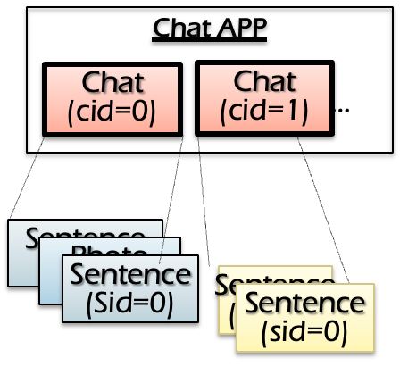

How is the key-value storage (KVS) deployed?
Approach #1: store the KVS at a centralized server
The server resides in a datacenter (e.g., 贵州)
The server can be made highly reliable (see later lectures)
e.g., on the user’s perspective, “never crashes”
All operations: execute an RPC at the server
What are the drawbacks?
Inefficiency! Must wait for server ACKs
Cannot work with offline!
Server
Network
X
Y
Client
Add sentence X
Read sentence Y
Client
Notes:
Can tolerate more failures than a phoen

Slide 52
How is the key-value storage (KVS) deployed?
Approach #2: store the KVS at a centralized server + at each device
Default implementation of many ChatAPP, e.g., WeChat ☺
Question: how to do the updates? We need to sync with other devices!
Naïve solution
Read: return the latest copy on the local KVS
Write: update the local KVS, sync with other KVS, then return to client
Client
Client
Server
Notes:
Can tolerate more failures than a phoen

Slide 53
Naïve solution: wait sync for each updates
Read: return the latest copy on the local KVS
Write: update the local KVS, sync with other KVS, then return to client
Time
Hello world
KVS write
Start
Hello world
Done
Hello world
Server
Notes:
Timeline
TBD: 动画

Slide 54
Naïve solution: wait sync for each updates
Problem#1: inefficiency
Each write must wait for the sync to be done, which may be lengthy
Numbers every programmer is suggested to know
RTT among devices: 100 – 400ms
Start
Done
Server

Slide 55
Naïve solution: wait sync for each updates
Problem#2: cannot tolerate network connectivity
Periodic connectivity to net and other nodes (e.g., lost WIFI)
Common under the setup of chat APP (e.g., I have entered the subway ☺)
Under network disconnection, the sender will be blocked
Start
Server

Slide 56
Naïve solution++: sync but not wait
Read: return the latest copy on the local KVS
Write: update the local KVS, sync with the others in background & return
Time
Hello world
KVS write
Start
Done
Server

Slide 57
Question: what can go wrong?
Considering the following scenario:
Me -> Boss: boss, I want to quit
Boss -> HR: Yubin (me) wants to quit
Boss -> Me: OK
Me -> HR: Boss has confirmed that I can quit (link to msg 2).
The HR’s job:
If sees “Boss has confirmed that I can quit” from Yubin, check whether “Yubin wants to quit” has been sent by the boss

Slide 58



Question: what can go wrong?
I want to quit
Me
Boss has confirmed that I can quit (link to msg 2).
Yubin wants quit
Boss
Ok
Message lost
HR

Slide 59
Question: what can go wrong? (Abstracted version)
Example scenario
Me -> Boss: boss, I want to quit
Boss -> HR: Yubin wants to quit (x)
Boss -> Me: OK
Me -> HR: Boss has confirmed that I can quit (link to msg x). (y)
The HR’s job:
If sees “Boss has confirmed that I can quit. ” (y’s update), check whether “Yubin wants to quit” has been sent (x must have been updated)

Slide 60
Question: what can go wrong? (Abstracted version)
We have two data, X and Y (initialized as 0)
Process #1: Put (X,1), Put (Y,1)
Process #2: If sees Y = 1, Print (X) // must be 1
Unexpected behavior
Process #2 sees Y = 1, But not X = 1
Notes:
C0: PUT("x",1);
PUT("y",1);
C1:
while ((y = GET("y"))!=1);
x = GET("x");
print x, y
Intuitive intent: C1 should print x=1, y=1

Slide 61
Question: what can go wrong? (Abstracted version)
Unexpected behavior
Process sees Y = 1, But not X = 1
Questions
Can the unexpected behavior happen in approach #1 (a single centralized KVS and RPC for all the operation implementation)?
Put(X,1)
Put(Y,1)
P0
Get(Y) = 1
Get(X) = 1
P1
Notes:
C0: PUT("x",1);
PUT("y",1);
C1:
while ((y = GET("y"))!=1);
x = GET("x");
print x, y
Intuitive intent: C1 should print x=1, y=1
Depends on the implementation

Slide 62
Question: what can go wrong? (Abstracted version)
Unexpected behavior
Process sees Y = 1, But not X = 1
Questions
Can the unexpected behavior happen in approach #1 (a single centralized KVS)? No.
Can the unexpected behavior happen in approach #2’s naïve (sync for each update)? No.
Notes:
C0: PUT("x",1);
PUT("y",1);
C1:
while ((y = GET("y"))!=1);
x = GET("x");
print x, y
Intuitive intent: C1 should print x=1, y=1

Slide 63
Naïve++ is efficient, but have unexpected behavior
An trade-off. The unexpected behavior is usually called inconsistency
How can we write correct distributed programs?
The developer must cope with inconsistency issues!
How to cope with inconsistency?
The system must provide a consistency model when operating the distributed data

Slide 64
What is consistency model?
Consistency model defines rules for the apparent order and
visibility of updates, and it is a continuum with tradeoffs.
- Todd Lipcon
Single object consistency is
also called “coherence”
Examples
Local shared virtual memory
Database
W(y) 1
R(y) (should be 1)
Time
X <- X + 1 ; Y <- Y - 1
Assert X+Y unchanged
Consistency across multiple objects
e.g., all-or-nothing + before-or-after
Notes:
Todd Lipcon: Hadoop and H

Slide 65
Consistency Challenges
No Right or Wrong consistency models
Tradeoffs between ease of programmability & performance
Why programmability?
Unexpected behavior usually needs to be fixed by the developers ☺
Consistency is hard in (distributed) systems
Data replication (& caching)
Concurrency (multi-core & multi-server)
Failures (e.g., machine or network)

Slide 66
Spectrum of Consistency Models
Better performance/
Fault tolerance
Sequential
Strict
Eventual
Release
Linearizability
Easy to use
Note that many other models exists

Slide 67
What is the desired model for the developers/users?
It's easy for users to reason about correctness assuming
Everything has only one-copy
The overall behavior is equivalent to some serial behavior

Slide 68
Example: equivalence to some serial execution
Though being concurrent, we can map it to some serial order
E.g., one device, execute the chat one by one (as a atomic unit)
Put(X,1)
Done
Put(Y,1)
Done
P0
Get(Y)
1
Get(X)
1
P1
Put(X,1)
Done
Done
Put(Y,1)
Get(Y)
1
Get(X)
1
Notes:
C0: WR(x=1) WR_ok(x) WR(y=1) WR_ok(y) C1: RD(y=?) RD_ok(y=1) RD(x=?) RD(x=1)
An equivalent sequential history
C0: C1:
C0: C1:
WR(x=1) WR_ok(x) WR(y=1) WR_ok(y)
WR(x=1)
WR_ok(x) RD(y=?) RD_ok(y=1)
RD(y=?) RD_ok(y=1) RD(x=?) RD(x=1) WR(y=1) WR_ok(y) RD(x=?) RD(x=0)
An "equivalent" sequential history C0: WR(x=1) WR_ok(x) WR(y=1) WR_ok(y) C1: RD(x=?)RD_ok(x=0)

Slide 69
Can this concurrent exe. equivalent to some serial exe.?
Though being concurrent, it is easier to understand if we map it to some serial execution
Put(X,1)
Done
Put(Y,1)
Done
P0
Get(Y)
0
Get(X)
0
P1
Get(Y)
0
Put(X,1)
Done
Put(Y,1)
Done
Get(X)
0
Notes:
Less intuitive, but still correct

Slide 70
Can this concurrent exe. equivalent to some serial exe.?
Though being concurrent, it is easier to understand if we map it to some serial execution
Put(X,1)
Done
Put(Y,1)
Done
P0
Get(Y)
1
Get(X)
0
P1
Can you derive an equivalent serial order?
Notes:
Less intuitive, but still correct

Slide 71
Proof: we cannot find an equivalent serial execution
Case #1.
Get(Y)
0
Put(X,1)
Done
Put(Y,1)
Done
Get(X)
0
Case #2.
Put(X,1)
Done
Done
Put(Y,1)
Get(Y)
1
Get(X)
1

Slide 72
Proof: we cannot find an equivalent serial execution
Case #3.
Get(Y)
0
Put(X,1)
Done
Put(Y,1)
Done
Get(X)
1
Case #4.
Get(Y)
0
Put(X,1)
Done
Put(Y,1)
Done
Get(X)
1
Notes:
Case study： HR 没看到我发的 消息，所以不会去看X

Slide 73
Proof: we cannot find an equivalent serial execution
Case #5.
Put(X,1)
Done
Get(Y)
0
Put(Y,1)
Done
Get(X)
1
Case #6.
Put(X,1)
Done
Get(Y)
0
Put(Y,1)
Done
Get(X)
1
Notes:
Case study： HR 没看到我发的 消息，所以不会去看X

Slide 74
Key problem: order mismatches
Put(X,1)
Done
Put(Y,1)
Done
P0
Get(Y)
1
Get(X)
0
P1
Update order observed by P0:
X first, then Y
Update order observed by P1:
Y first, then X
In a serial order, only one can happen

Slide 75
Recall: What is the right model?
It's easy for users to reason about correctness assuming
Everything has only one-copy
The overall behavior is equivalent to some serial behavior
Typically, a convenient consistency model is defined by
Every data has only “one copy” (logically)
The concurrent read/write behavior is equivalent to some serial order
Question: which serial order to give?
So many (possible) serial behaviors

Slide 76
How to define the equivalent serial order?
#1. Global issuing order (strict consistency)
#2. Per-process issuing/completion order (sequential consistency)
#3. Global "completion-to-issuing" order (linearizability)

Slide 77
Try #1. Use strict consistency
Strict consistency: global issuing order
All the concurrent execution is equivalent to a serial execution
The order of each op matches the global wall clock time
Example
Put(X,1)
Done
Put(Y,1)
Done
P0
Issue time
Get(Y)
1
Get(X)
1
P1
Put(X,1)
Done
Done
Put(Y,1)
Get(Y)
1
Get(X)
1

Slide 78
Try #1. Use strict consistency
Is the following serial order matches global issuing time?
No. Put (X,1) must be executed first.
Put(X,1)
Done
Put(Y,1)
Done
P0
Get(Y)
0
Get(X)
0
P1
Get(Y)
0
Put(X,1)
Done
Put(Y,1)
Done
Get(X)
0

Slide 79
Try #1. Use strict consistency
Is the following serial order matches global issuing time?
No. Put(Y) must be executed before the Get(Y)
Put(X,1)
Done
Put(Y,1)
Done
P0
Issue time
Get(Y)
0
Get(X)
1
P1
Put(X,1)
Done
Put(Y,1)
Done
Get(Y)
0
Get(X)
1

Slide 80
Strict consistency: Pros & Cons
Pros
The strongest consistency model for single value operations
Fallback to a single thread, executing each operations one by one
Cons
Nearly impractical to implement (e.g., no global wall clock time)

Slide 81
Implementing strict consistency: challenge
Assuming we implement strict consistency using a centralized KVS
The simplest setup we can get in a distributed setting
Question: how the KVS can determine to process Put(Y,1) or not?
Put(X,1)
P0
Put(Y,1)
P1

Slide 82
How to define the equivalent serial order?
#1. Global issuing order (strict consistency)
#2. Per-process issuing/completion order (sequential consistency)
#3. Global "completion-to-issuing" order (linearizability)
Also convenient, but are practical to implement

Slide 83
Try #2. Use sequential consistency
#2. Per-process issuing/completion order (sequential consistency)
All the concurrent execution is equivalent to a serial execution
The order of each op matches per-process issuing/completion order
Put(X,1)
Done
Put(Y,1)
Done
P0
Get(Y)
0
Get(X)
0
P1
Allowed
Get(Y)
0
Put(X,1)
Done
Put(Y,1)
Done
Get(X)
0

Slide 84
Try #3. Use linearizability
#3. Linearizability "completion-to-issuing" order
All the concurrent execution is equivalent to a serial execution
The order of each op matches "completion-to-issuing"
Put(X,1)
Done
Put(Y,1)
Done
P0
Done time
Get(Y)
0
Get(X)
0
P1
Issue time
Allowed
Get(Y)
0
Put(X,1)
Done
Put(Y,1)
Done
Get(X)
0
Notes:
Read the most recent writes

Slide 85
Question: what are the differences between 1 & 3?
Recall: the following scenario can happen in 3 but not 1
Put(X,1)
Done
Put(Y,1)
Done
P0
Issue time
Get(Y)
1
Get(X)
1
P1
Put(X,1)
Done
Put(Y,1)
Done
Get(Y)
1
Get(X)
1

Slide 86
2 or 3, which to choose?
In practice, 3 is in favor of 2
E.g., P0 finishes X. But later P1 cannot sees its effect!
Put(X,1)
Done
Put(Y,1)
Done
P0
Get(Y)
0
Get(X)
0
P1
Allowed
Get(Y)
0
Put(X,1)
Done
Put(Y,1)
Done
Get(X)
0

Slide 87
Implementing linearizability of KVS

Slide 88
Warmup property of linearizability: The local property ^{[1]}
If each object’s op is linearizable, then overall system is linearizable
Our implementation only needs to focus on a single object !
(Very) Simplified & (very) informal proof (By contradiction)
Suppose we have two ops on x,y, e1 & e2
If non-linearizable, then we must have e1 < e2 & e2 < e1
This is impossible:
e1 < e2 means real_time(e1_ok) < real_time(e2_start)
real_time(e2_start) < real_time(e2_ok)
e2 < e1 means real_time(e2_ok) < real_time(e1_start)
Since real_time(e1_start) < real_time(e1_ok), contradiction happens
The concrete proof needs to reason on multiple ops & objects (w/ graph)
[1] Linearizability: A Correctness Condition for Concurrent Objects， TPLS’90

Slide 89
Why locality is important to implement linearzability? We only need to ensure operations on a single object is linearzable!

Slide 90
The simplest approach: centralized KVS
Basic model
There is only one centralized KVS in the system
Put: Send an RPC to the KVS, wait for it to be done
Get: Send an RPC to the KVS to read the result
Put(X,1)
Put(X,1)
P0
It is incorrect to view the put as done if the ack is not received
P1
Get(X)
Notes:
Why not this approach?

Slide 91
Approaches for replicated KVS: replicated KVS
Model (More suitable for the chat app)
Each device has a replicated KVS on its local machine
Question: how can the Get/Put being implemented?
P0
P1

Slide 92
Approaches for replicated KVS (more realistic)
Put
How many servers need the client send the updates to?
Must a client wait till all servers sent have processed the update?
Read
Which server will the read sent to?
Can a server always return its current value?
P0
P1

Slide 93
Approach #1. Primary-backup model
For each object, Clients send all reads/writes at a designated machine
For writes
Primary forwards writes to all the replicas
M0 executes writes locally (in order)
Respond OK
Primary
Write(x,1)
Write locally
Done
P0
forward
forward
P1

Slide 94
What does the 「in order」 mean?
Suppose we have two writes send to the primary
Due to network problem, the message may reorder
If the reorder happens, it is possible that two replicas apply the same writes in a different order!
Primary
Write(x,1)
Write(x,2)
P0
1
2
forward
P1
2
1

Slide 95
In order updates: Primary must use some seq number
Seq number: orders of update
Possible implementation: a global counter
Incremented upon receive a write request
All replica apply writes in the order of seq number
Delay writes if the previous write has not been finished
Primary
Write(x,1)
Write(x,2)
P0
1
2
1
2
Forward <2, 1>
Forward <1, 1>
P1
0
1
2

Slide 96
Question: where to implement the in-order semantic?
At the network layer
May rely on the transport (e.g., RPC or TCP/IP) layer to implement
But we can also implement it at the application layer
E.g., the primary stores a global counter
Not so hard, and is more flexible
Primary
Write(x,1)
Write(x,2)
P0
1
2
1
2
Forward <2, 1>
Forward <1, 1>
P1
0
1
2

Slide 97
Approach #1. Primary-backup model
For writes
Primary forwards writes to all the replicas
M0 executes writes locally (in order)
Respond OK
Read: return the local copy of the data of the primary
Primary
Write(x,1)
Write locally
Done
P0
Read(x)
1
forward
forward
P1

Slide 98
Drawback of the primary-backup model
Performance issues of reads and writes
Read: extra RTT for contacting the primary
Writes: extra RTTs for contacting the primary + backups
Scalability issue: the primary may become the bottleneck!
Reliability issue: what if some primary of backups crash? (Not today)
Primary
Write(x,1)
Write locally
Done
P0
Read(x)
1
forward
forward
P1

Slide 99
Approach #2. Primary-backup model + Relaxed reads
For writes
Primary forwards writes to all the replicas
M0 executes writes locally (in order)
Respond OK
Read: return the local copy of the data on any replica
Primary
Write(x,1)
Write locally
Done
P0
Read(x)
1
forward
forward
P1

Slide 100
Question: Is approach #2 linearizable?
Read-2 < Read-1
Write < Read-1
Read-1 < Read-2 (Read-1’s completion is before Read-2)
Write(x,1)
Read-1(x)
Read-2(x)
0
Primary
1
Ok
P0
forward
P1

Slide 101
Left question: is the approach sequential consistent?
Further: how can we make it be?
Notes:
If each client sticks to sending all its requests to one machine (but different clients can send to different machines), our implementation is sequentially consistent (but not still linearizable)

Slide 102
Summary
It is challenging to distributed object distributed
Consistency issue
It is also challenging to define the consistency model
Different trade-offs
Correct consistency model is defined via serial execution
Strict
Sequential
Linearizable
Implementation trades performance (and reliability) for correctness

Slide 103
Case study: Distributed shared memory

Slide 104
A preview of distributing computing
Simple requests can be easily handled by DFS or databases
E.g., read a file, read a data record
Complex requests require huge computations
E.g., make a summation of an array of values
We will see more complex examples later
int data[100000];
int sum = 0;
for i in 100000:
sum += data[i]
print(sum)

Slide 105
Multiple threads for better performance
Traditional system is single-threaded
i.e., one thread continuously executing the application code
Challenge: single-thread performance is not growing
Due to end of Moore’s law, a single thread cannot become faster nowadays
Solution: multiple threads
Different threads running concurrently to finish the job

Slide 106
Example: parallel sum
Single-threaded version
Multiple-threaded version
int data[100000];
int sum = 0;
for i in 100:
sum += data[i]
print(sum)
int data[100000];
int sum = 0;
for i in nthreads:
start = 100000 / nthreads * i;
end = start + 100000 / nthreads;
create_thread(do_sum(start, end))
for i in nthreads:
sum += join_thread()
print(sum)

Slide 107
Example: parallel sum
Multiple-threaded version
extern int data[];
def do_sum(int start,int end) {
int local_sum = 0;
for i in start..end:
local_sum += data[i]
return local_sum
}
int data[100];
Iint sum = 0;
for i in nthreads:
create_thread(do_sum(start,end))
for i in nthreads:
sum += join_thread()
print(sum)

Slide 108
Example: parallel sum
Ideal case: with more threads, we can boost the performance
i.e., the computation time decreases with the number of threads
Question: how does each thread access the shared variable?
Each thread share the global memory address space (same page table)
extern int data[];
def do_sum(int start,int end) {
int local_sum = 0;
for i in start..end:
local_sum += data[i]
return local_sum
}
Page#, Physical
Page#, Physical
Data page, Addr
Data page, Addr
Thread 0
Thread 1
Page
int data[];

Slide 109
Problem: single machine is insufficient
Each machine has a limited resource to scale
The number of CPUs is limited (100 cores typically the maximum)
The capacity of memory is also limited (1TB typically the maximum)
int data[100000 1000000000000000000];
int sum = 0;
for i in nthreads:
create_thread(do_sum(100 / nthreads * i))
for i in nthreads:
sum += join_thread()
print(sum)

Slide 110
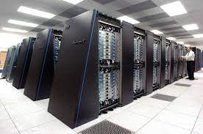
Observation: the cluster has (nearly) unlimited resources
The aggregated computing resources of a data center are huge
10PB + of memory
100,000 + CPU cores (threads)

Slide 111
Idea: global address space across multiple machine?
Multiple-threaded version / DSM
extern int data[];
def do_sum(int start,int end) {
int local_sum = 0;
for i in start..end:
local_sum += data[i]
return local_sum
}
int data[100];
Iint sum = 0;
for i in nthreads:
create_thread(do_sum(start, end))
for i in nthreads:
sum += join_thread()
print(sum)
So that we can run the same multi-threaded code on multiple machines!

Slide 112

Challenge: how can a CPU access remote mem address?
Stored on
Page#, Physical
…
Data page 0, Addr
Page 0
int data[0 : 512];
Page 1
int data[512 : 1024];
Thread 0
Machine 0
Page 2
Page 3
Page#, Physical
Stored on
…
Machine 1
Data page 0, Addr
…
…
Thread 1

Slide 113
Challenge: how can a CPU access remote mem address?
Stored on
Page#, Physical
…
Data page 0, Addr
Page 0
int data[0 : 512];
Page 1
int data[512 : 1024];
Thread 0
Machine 0
Page 2
What if thread 1 wants to access page 0?
Page 3
Page#, Physical
Stored on
…
Machine 1
Data page 0, Addr
…
…
Thread 1

Slide 114
Distributed shared memory

Slide 115
DSM: distributed shared memory
Transparently offer a distributed global address space to multiple machines
How to implement DSM? A strawman approach:
If a memory address is local, then CPU can directly use load/store to access it
If a memory address is remote, the kernel will fetch the page (through network) to local on-behave of the CPU (more details later)
Question: how does the kernel detect a remote page access?
Notes:
可以引申问题：这样的好处是什么？

Slide 116
Address layout of a thread in DSM
Kernel virtual memory
Stack for CPU0
…
Stack for CPU1
Each thread has its dedicated region
For stack & heap
Others are the same as a local thread
i.e., .text is stored locally
The physical addresses behind the other’s stack & heap are remote physical addresses
We can infer the destination from the virtual memory range , e.g., record a (va -> machine location) mapping in the kernel
…
Heap for CPU1
Heap for CPU0
Read/write segment
(.data, .bss)
Read-only segment
(.init, .text, .rodata)
Unused

Slide 117
Using page table to implement DSM
Suppose we only have three pages, two at machine 0 & one at machine 1
Page#, Physical, Present
Page 0
int data[0 : 512];
Data page 0, Addr0, 1
Data page 1, Addr1, 1
Page 1
int data[512 : 1024];
Machine 0
Data page 2, Addr2, 0
Page#, Physical, Present
Data page 0, Addr0, 0
Page 2
int data[1024 : 2048];
Data page 1, Addr1, 0
Machine 1
Data page 2, Addr2, 1

Slide 118
Using page table to implement DSM (Read)
extern int data[];
def do_sum(int start,int end) {
int local_sum = 0;
for i in start..end:
local_sum += data[i]
return local_sum
}
Page#, Physical, Present
Suppose CPU access data[0]
Data page 0, Addr0, 1
Data page 1, Addr1, 1
Machine 0
Data page 2, Addr2, 0
Page 0
int data[0 : 512];
Page 2
int data[1024 : 2048];
Machine 0
Page 1
int data[512 : 1024];
Machine 1

Slide 119
Using page table to implement DSM (Read)
extern int data[];
def do_sum(int start,int end) {
int local_sum = 0;
for i in start..end:
local_sum += data[i]
return local_sum
}
Page#, Physical, Present
Suppose CPU access data[1024]
Data page 0, Addr0, 1
Data page 1, Addr1, 1
Machine 0
Data page 2, Addr2, 0
Notice that the present bit is 0
Page 0
int data[0 : 512];
Page 2
int data[1024 : 2048];
Machine 0
Page 1
int data[512 : 1024];
Machine 1

Slide 120
Using page table to implement DSM (Read)
Remote page needs special treatment
Otherwise, the CPU will treat the remote physical address (Addr2) as a local physical address, reading a wrong value
We do this by mark the present bit as 0
Page#, Physical, Present
Page 0
int data[0 : 512];
Data page 0, Addr0, 1
Data page 1, Addr1, 1
Page 1
int data[512 : 1024];
Machine 0
Data page 2, Addr2, 0

Slide 121
Using page table to implement DSM (Read)
extern int data[];
def do_sum(int start,int end) {
int local_sum = 0;
for i in start..end:
local_sum += data[i]
return local_sum
}
Page#, Physical, Present
Suppose CPU access data[1024]
Data page 0, Addr0, 1
Data page 1, Addr1, 1
Machine 0
Data page 2, Addr2, 0
Request: read addr2
Page fault for Page 2 on data[1024]
The kernel sends a messages to machine 1 to read the page
Page 2
int data[1024 : 2048];
Machine 1

Slide 122
Using page table to implement DSM (Read)
extern int data[];
def do_sum(int start,int end) {
int local_sum = 0;
for i in start..end:
local_sum += data[i]
return local_sum
}
Page#, Physical, Present
Suppose CPU access data[1024]
Data page 0, Addr0, 1
Data page 1, Addr1, 1
Machine 0
Data page 2, Addr2, 0
int data[1024 : 2048];
Page fault for Page 2 on data[1024]
The kernel sends a messages to machine 1 to read the page
Machine 1 sends back the page
Page 2
int data[1024 : 2048];
Machine 1

Slide 123
Using page table to implement DSM (Read)
extern int data[];
def do_sum(int start,int end) {
int local_sum = 0;
for i in start..end:
local_sum += data[i]
return local_sum
}
Page#, Physical, Present
Suppose CPU access data[1024]
Data page 0, Addr0, 1
Data page 1, Addr1, 1
Machine 0
Data page 2, Addr2, 0
Page c
int data[1024 : 2048];
Page fault for Page 2 on data[1024]
The kernel sends a messages to machine 1 to read the page
Machine 1 sends back the page
Machine 0 allocates a new page to store the data (Page c)

Slide 124
Using page table to implement DSM (Read)
extern int data[];
def do_sum(int start,int end) {
int local_sum = 0;
for i in start..end:
local_sum += data[i]
return local_sum
}
Page#, Physical, Present
Suppose CPU access data[1024]
Data page 0, Addr0, 1
Data page 1, Addr1, 1
Machine 0
Data page 2, AddrC, 1
Page c
int data[1024 : 2048];
Page fault for Page 2 on data[1024]
The kernel sends a messages to machine 1 to read the page
Machine 1 sends back the page
Machine 0 allocates anew page to store the data (Page c)
Modify the page table
Return to the user program

Slide 125
The solution essentially caches the remote page locally
If we read the remote page, allocate a local page and caches it
Question:
What would happen when machine 1 makes a modification?
On machine 0, future read will get a stale value!
Naïve solution
Machine 0 invalidates the page once the application finishes the read
Question remains: how can the kernel know when the application has finished reading the data w/o changing the program?
If we rely on the application modifications, we cannot directly run multi-threaded program on DSM!
Also, invalidation degrades the performance

Slide 126
Cache or not cache? It is a trade-off
Cache improves the performance of future reads
Network is much slower than local memory accesses
E.g., 10ms (network) vs. 100ns (local memory access)
Especially difficult to reduce for large-scale clusters
Cache introduces anomalies if not implementing properly
E.g., application reads a stale data
Whether it is ok depends on the application scenarios
Our parallel sum works fine, but what about others? (will see later)

Slide 127
What about Write?
extern int data[];
def do_sum(int start,int end) {
int local_sum = 0;
for i in start..end:
data[i] += 73;
return local_sum
}
Page#, Physical, Present, RW
Suppose CPU write data[1024]
Data page 0, Addr0, 1,Write
Data page 1, Addr1, 1,Write
Machine 0
Data page 2, AddrC, 1,Read
Page c
int data[1024 : 2048];
Page 2
int data[1024 : 2048];
Besides read, we need to write back
Question: how can kernel detect there is a write?
Setting the write-bit of the page to 0, even it is write-permitted

Slide 128
What about Write?
extern int data[];
def do_sum(int start,int end) {
int local_sum = 0;
for i in start..end:
data[i] += 73;
return local_sum
}
Page#, Physical, Present, RW
Suppose CPU write data[1024]
Data page 0, Addr0, 1,Write
Data page 1, Addr1, 1,Write
Machine 0
Data page 2, AddrC, 1,Read
Page c
int data[1024 : 2048];
Page fault for Page 2 on data[1024]
The kernel checks whether it is ok to write the page
Mark the page as dirty
Mark the page as write
Page 2
int data[1024 : 2048];
Wait for a while, and write the page back

Slide 129
Write the data back to remote is tricky
The kernel cannot decide when the client finishes the write
It can only detect there is an on-going write
Therefore, the write back is flushed later in a timely manner
Note that the write back will also need to update other’s cache
This is essentially the consistency issue we met before!

Slide 130
Recap of our simple DSM so far
Kernel handles the remote page’s read/write
With the help of the page table
Kernel caches the remote pages to improve performance
Also not relies on the application to flush the page
The fastest DSM implementation (naïve)
Read: always read from the cache
Write: send updates to the remote (and caches) in a timely manner
However, the fastest implementation would result in subtle consistency issues

Slide 131
Consistency Issue of DSM

Slide 132
Example: Mutual Exclusion on naïve DSM
extern int x; //0
extern int y; //0
x = 1
if (y==0)
critical sec
CPU1
extern int x;//0
extern int y;//0
y = 1
if (x==0)
critical sec
CPU0
Read/Write
DSM
Assumptions
CPU0 and CPU1 are on different machines
x and y reside on different pages and have been cached to two machines
Goal: critical section
Two CPUs should not execute the code simultaneously
Notes:
SVM simplifies application development

Slide 133
OK case: CPU0 goes first
x = 1
if (y==0)
critical sec
y = 1
if (x==0)
critical sec
CPU0
CPU1
W(x) 1
R(y) 0
Network
W(y) 1
R(x) 1
Time
Time

Slide 134
OK case: CPU1 goes first
x = 1
if (y==0)
critical sec
y = 1
if (x==0)
critical sec
CPU0
CPU1
W(y) 1
R(x) 0
Network
W(x) 1
R(y) 0
Time
Time

Slide 135
OK case, may need to handle, but still OK
x = 1
if (y==0)
critical sec
y = 1
if (x==0)
critical sec
CPU0
CPU1
W(x) 1
W(y) 1
Network
R(y) 1
R(x) 1
Time
Time

Slide 136
Bad case!!!
Cache states
x = 1
if (y==0)
critical sec
X=0
Y=0
X=0
Y=0
y = 1
if (x==0)
critical sec
CPU0
CPU1
W(x) 1
W(y) 1
R(y) 0
R(x) 0
Network
Time
Time

Slide 137
Can this happen under linearizability? No
Goal: proof no two nodes/CPUs enter the critical section
Proof: suppose mutual exclusion is violated, then we have:
CPU-0:
CPU-1:
W(x) 1
R(y) 0
W(y) 1
R(x) 0
R(x) 0
W(x) 1
R(y) 0
W(y) 1
Time
extern int x;
extern int y;
x = 1
if (y==0)
critical sec
extern int x;
extern int y;
y = 1
if (x==0)
critical sec

Slide 138
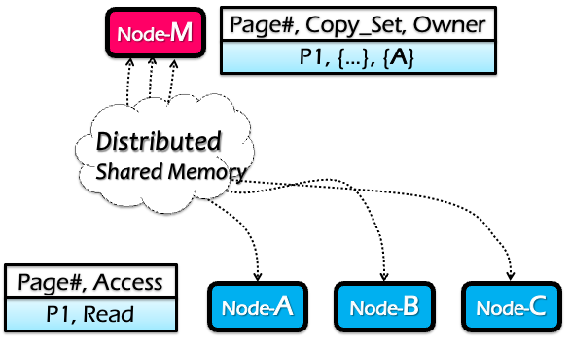
Implementation: primary-backup model + read copies
A centralized node maintains a table which has the following info per-page
Owner machine: the most recent machine that has write access to it
Copy set: all machines that have copies of this page
Only the owner is allowed to do the update

Slide 139
Read copies: read-only replicas for better performance
The machine can read its read copy if no machine is updating it
For better performance: reduced RTT
What if a machine is updating the page?
We must first invalidate all the read copies
Essentially fallback to the primary-backup model

Slide 140
Read operations (at node C, the first time)
RQ: Read reQuest
RF: Read Forward
RC: Read Confirm
Node-M
Page#, Copy_Set, Owner
P1, { }, { }
C
A
3: RF
Page fault for P1 on C
C sends RQ to M
M sends RF to A, M adds C to Copy_Set
A sends P1 to C, C marks P1 as Read-only
C sends RC to M
5: RC
Distributed Shared Memory
2: RQ
4: P1
Node-A
Node-B
Node-C
Page#, Access
Page#, Access
...
P1, Read
P1, Read

Slide 141
Write operations (at node B)
WQ: Write reQuest
IV: Invalidate
IC: Invalidate Confirm
WF: Write Forward
WC: Write Confirm
Node-M
Page#, Copy_Set, Owner
P1, { }, { }
C
A
B
5: WF
Page fault for P1 on B
B sends WQ to M
M sends IV to Copy_Set={C}
C send IC to M
M clears Copy_Set, sends WF to A
A sends P1 to B, clear Access
B send WC to M
3: IV
Distributed Shared Memory
4: IC
7: WC
6: P1
2: WQ
Node-A
Node-B
Node-C
Why does it need WC?
Page#, Access
Page#, Access
Page#, Access
P1, Read
P1, Write
P1, nil
To prevent another write become an onwer
P1, nil
P1, Read

Slide 142
DSM Invariants
Every page has exactly one current owner (primary-backup)
Current owner has a copy of the page
If mapped r/w by owner, no other copies
If mapped r/o by owner, identical to other copies
Centralized manager knows about all copies

Slide 143
DSM summary
RPC
Distributed shared memory
Pros:
Program a cluster of machines like a single machine => easy to program
Sequential consistency
Cons
Scalability bottleneck of the global manager
Single-point of failure
Many synchronizations upon reads/writes
Scalability
Ease of
programming
Performance
Consistency
Fault tolerance
Notes:
五芒星图

Slide 144
Drawback of strong consistency model
In any implementation of SC, there should be some global control mechanism
Scalability & fault-tolerance challenges
Either of writes or reads require memory synchronization operations
Performance issue
W(x)
W(y)
W(x)
Node-0
Time
It’s necessary
Time
Node-1
R(x)
R(y)
R(x)

Slide 145
Drawback of strong consistency model
In any implementation of SC, there should be some global control mechanism
Scalability & fault-tolerance challenges
Either of writes or reads require memory synchronization operations
Performance issue
W(x)
W(x)
W(x)
Node-0
Time
What about this?
Time
Node-1
R(y)
R(y)
R(y)

Slide 146
Drawback of strong consistency model
Problem: false sharing
Two or more machines access different variables within a page
and at least one of the accesses is a write.
W(x)
W(x)
W(x)
Node-0
Time
x
“Ping-pong”
y
Time
Node-1
R(y)
R(y)
R(y)

Slide 147
Drawback of strong consistency model
Problem: false sharing
Drawbacks
Ping-Pong: the ownership of pages is transferred between two (irrelevant) machines
Write amplifications: even I update an integer (8B), the DSM will transfer the entire page (4KB)
x
y

Slide 148
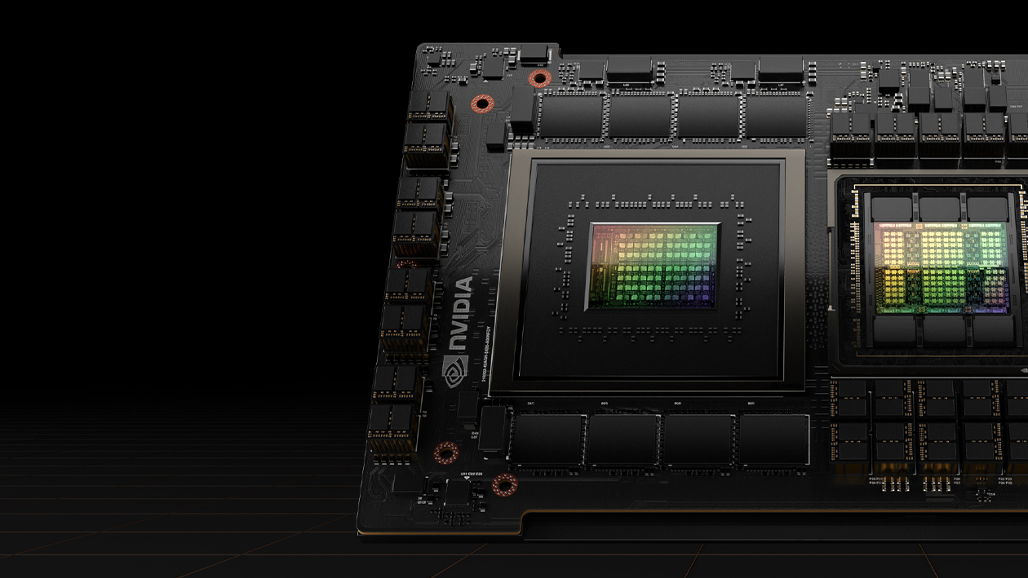
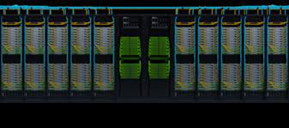

Summary of DSM
DSM: a not “so successful” technique
Due to the costs of strong consistent memory models
But it motivates many other systems (or hardware)
Global address space, e.g., NVIDIA’s GraceHopper
Networking for fast remote memory access, i.e., RDMA
Notes:
Gracehopper implements DSM in hardware, but is default disabled for better performance

